Slide 1
some general stuff on
The QROM
Gorjan Alagic
NIST internal
8/26/2020

Slide 2
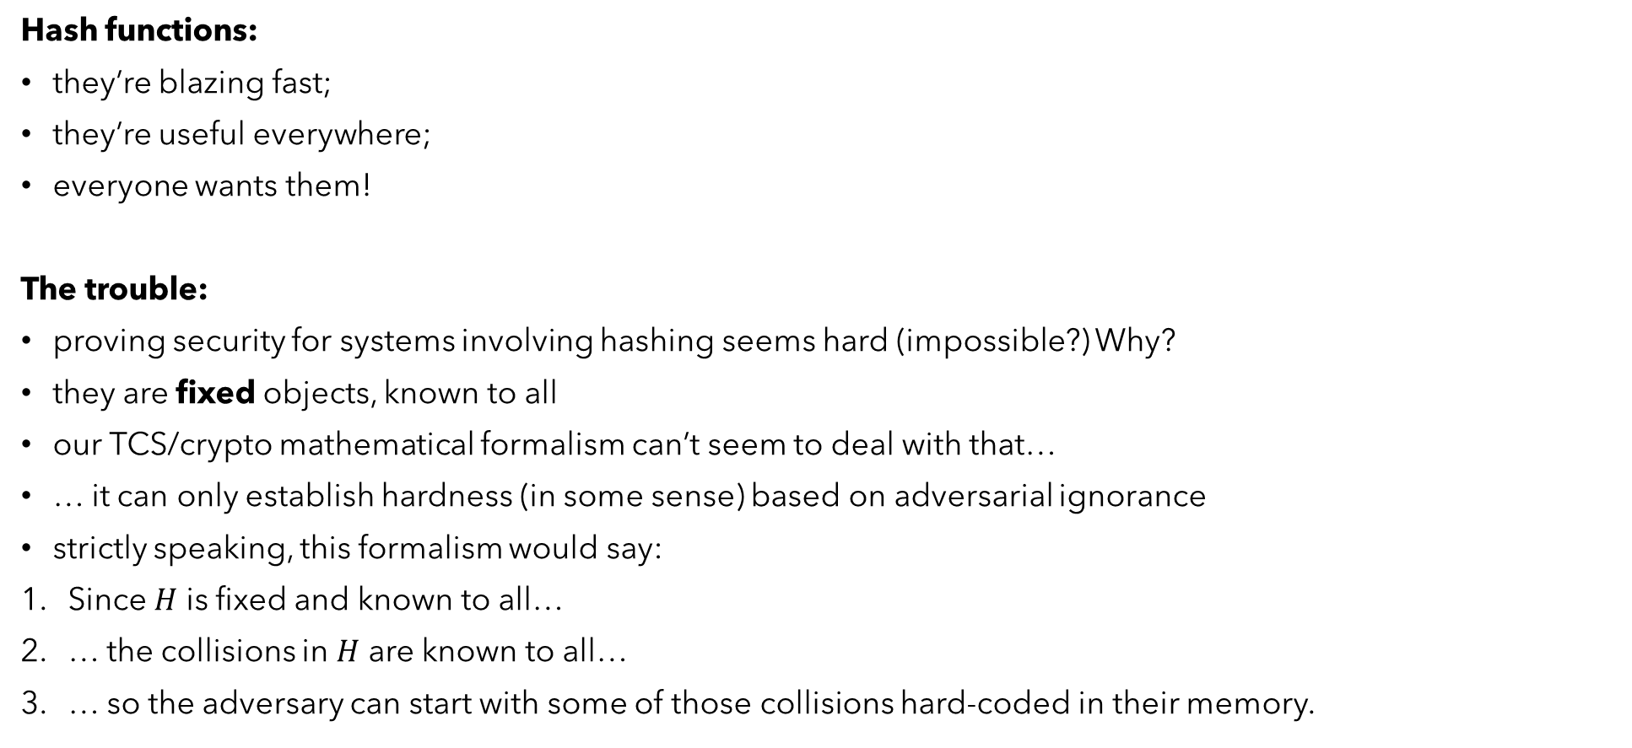
Random oracle model: my POV
Hash functions:
they’re blazing fast;
they’re useful everywhere;
everyone wants them!
The trouble:
proving security for systems involving hashing seems hard (impossible?) Why?
they are fixed objects, known to all
our TCS/crypto mathematical formalism can’t seem to deal with that…
… it can only establish hardness (in some sense) based on adversarial ignorance
strictly speaking, this formalism would say:
Since $H$ is fixed and known to all…
… the collisions in $H$ are known to all…
… so the adversary can start with some of those collisions hard-coded in their memory.
Real cryptanalysts: What? NO!

Slide 3
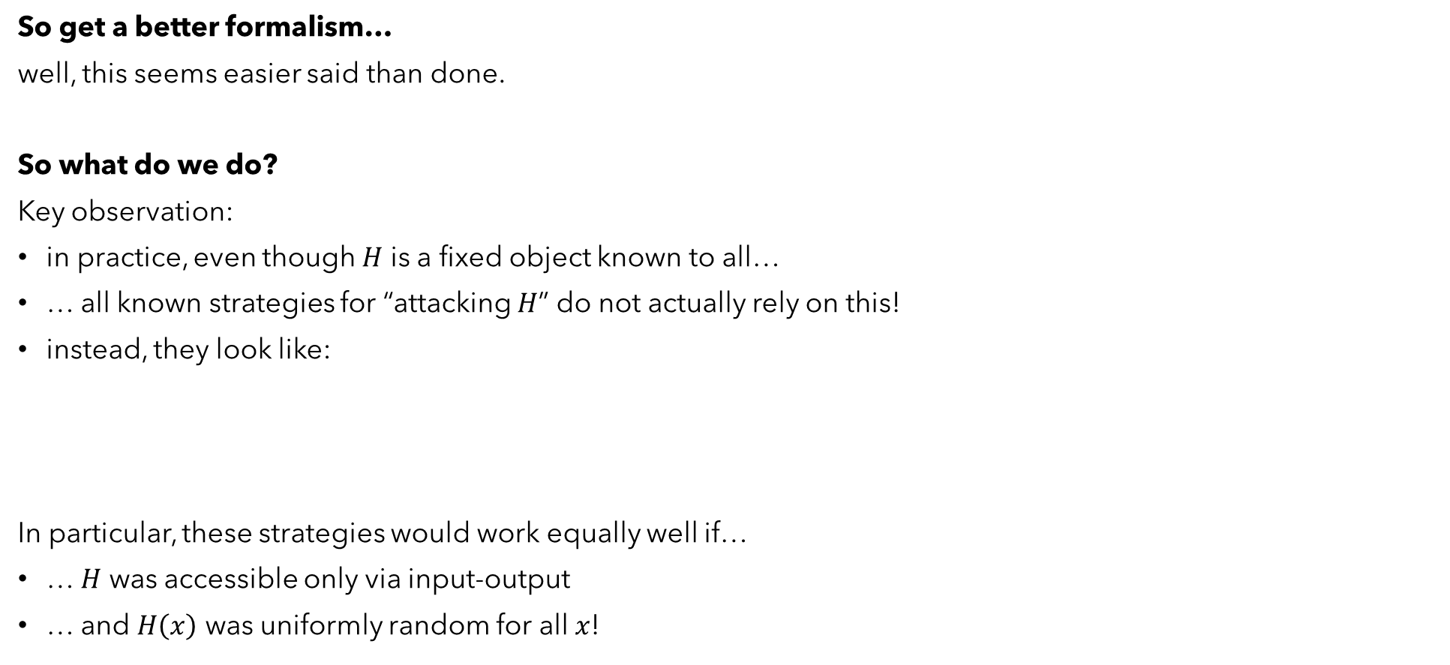
Random oracle model: my POV
So get a better formalism…
well, this seems easier said than done.
So what do we do?
Key observation:
in practice, even though $H$ is a fixed object known to all…
… all known strategies for “attacking $H$” do not actually rely on this!
instead, they look like:
In particular, these strategies would work equally well if…
… $H$ was accessible only via input-output
… and $H\left(x\right)$ was uniformly random for all $x$!
Plug something in, see what comes out, i.e., $x↦H(x)$;
Do (1) repeatedly until something interesting happens (collision, inversion, etc.);

Slide 4



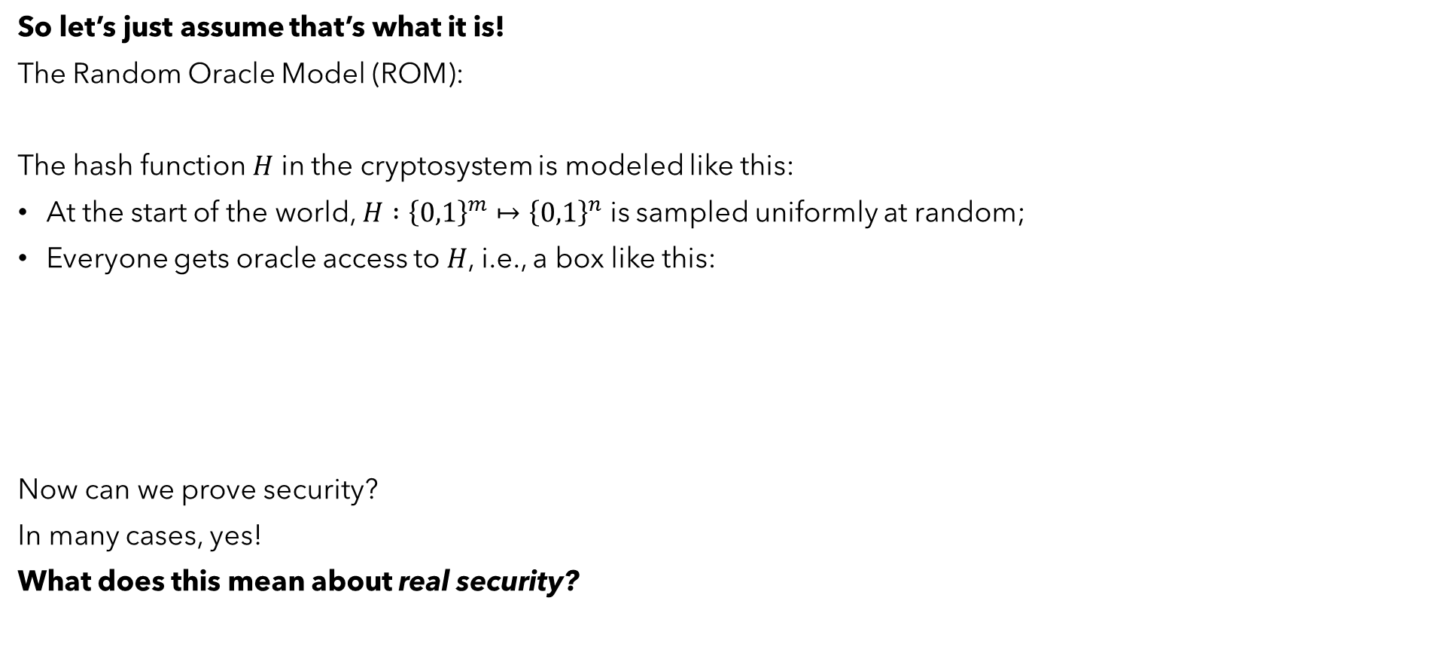
Random oracle model: my POV
So let’s just assume that’s what it is!
The Random Oracle Model (ROM):
The hash function $H$ in the cryptosystem is modeled like this:
At the start of the world, $H :{\left\{0,1\right\}}^{m}↦{\left\{0,1\right\}}^{n}$ is sampled uniformly at random;
Everyone gets oracle access to $H$, i.e., a box like this:
Now can we prove security?
In many cases, yes!
What does this mean about real security?
$$H$$
$$x$$
$$H(x)$$

Slide 5
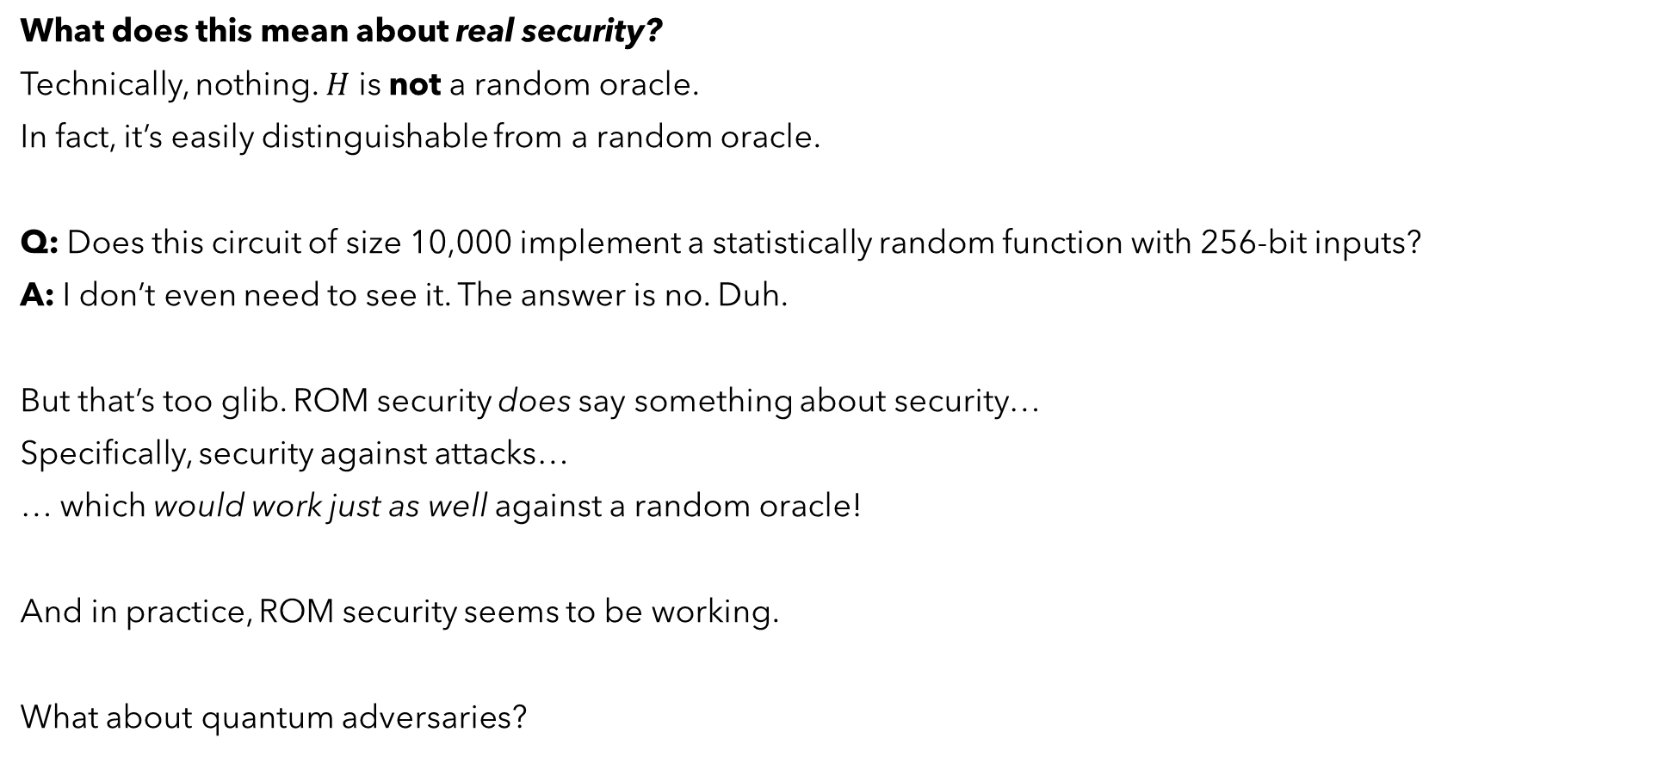
Random oracle model: my POV
What does this mean about real security?
Technically, nothing. $H$ is not a random oracle.
In fact, it’s easily distinguishable from a random oracle.
Q: Does this circuit of size 10,000 implement a statistically random function with 256-bit inputs?
A: I don’t even need to see it. The answer is no. Duh.
But that’s too glib. ROM security does say something about security…
Specifically, security against attacks…
… which would work just as well against a random oracle!
And in practice, ROM security seems to be working.
What about quantum adversaries?

Slide 6

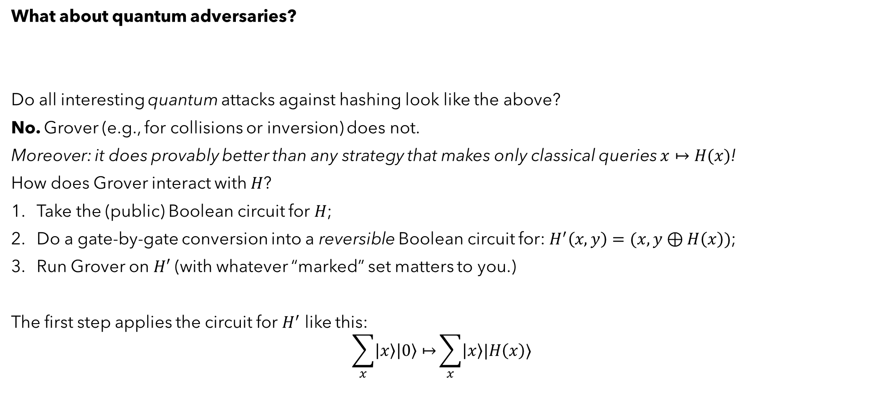
Random oracle model: quantum?
What about quantum adversaries?
Do all interesting quantum attacks against hashing look like the above?
No. Grover (e.g., for collisions or inversion) does not.
Moreover: it does provably better than any strategy that makes only classical queries $x↦H(x)$!
How does Grover interact with $H$?
Take the (public) Boolean circuit for $H$;
Do a gate-by-gate conversion into a reversible Boolean circuit for: $H^{′}\left(x, y\right)=(x, y⊕H\left(x\right))$;
Run Grover on $H′$ (with whatever “marked” set matters to you.)
The first step applies the circuit for $H^{′}$ like this:
$$\sum_{x}{\left|x\right\rangle \left|0\right\rangle ↦}\sum_{x}{\left|x\right\rangle |H\left(x\right)⟩}$$
Plug something in, see what comes out, i.e., $x↦H(x)$;
Do (1) repeatedly until something interesting happens (collision, inversion, etc.);
Does NOT look like $x↦H(x)$!

Slide 7
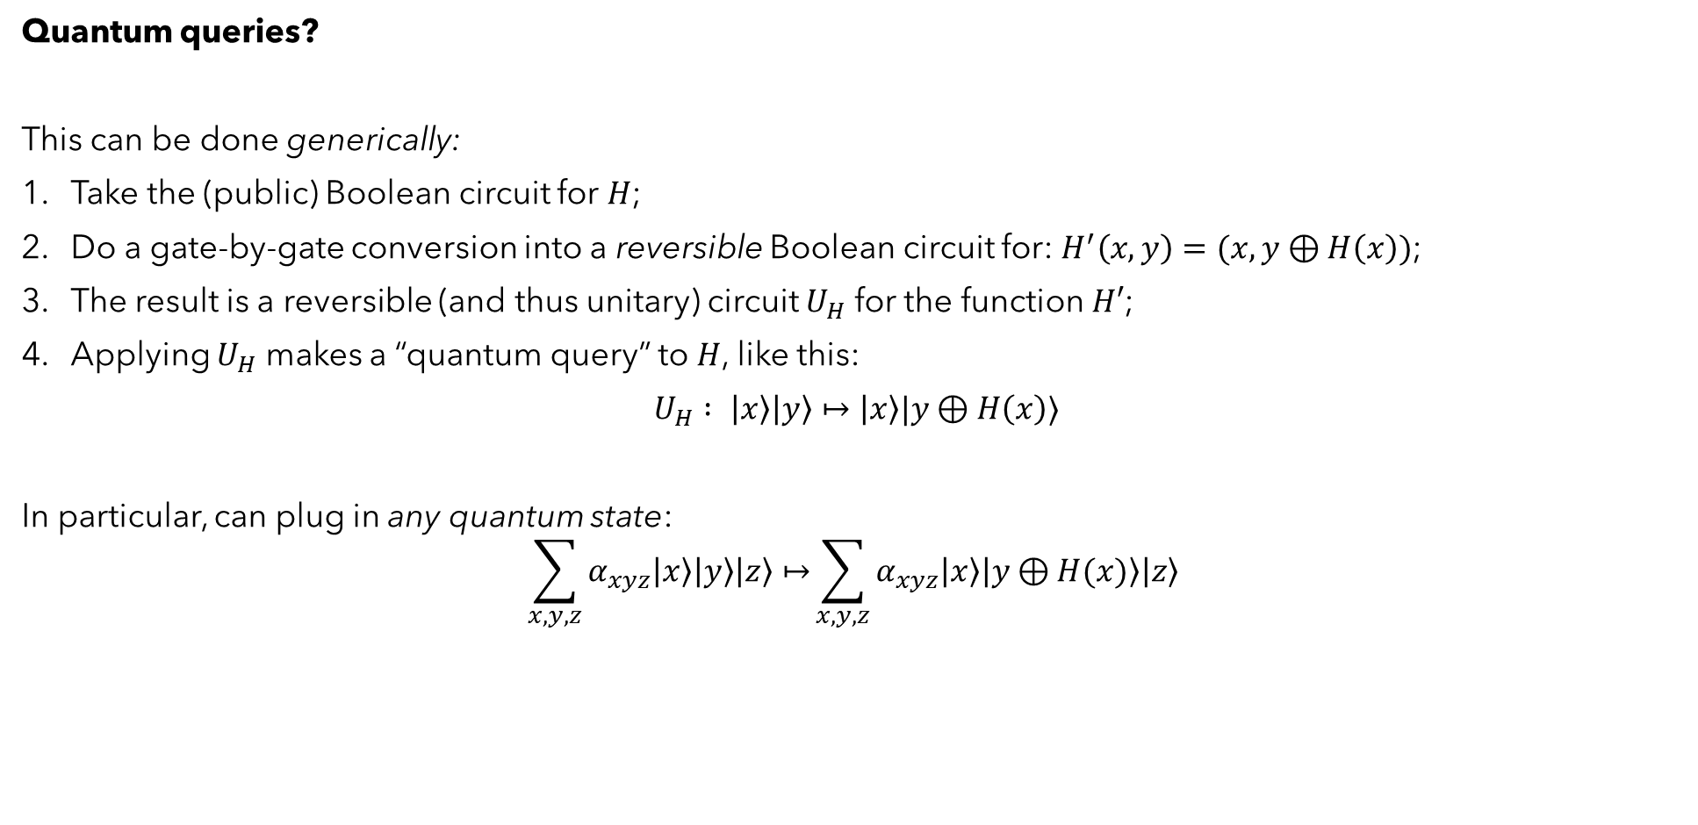
Random oracle model: quantum?
Quantum queries?
This can be done generically:
Take the (public) Boolean circuit for $H$;
Do a gate-by-gate conversion into a reversible Boolean circuit for: $H^{′}\left(x, y\right)=(x, y⊕H\left(x\right))$;
The result is a reversible (and thus unitary) circuit $U_{H}$ for the function $H′$;
Applying $U_{H}$ makes a “quantum query” to $H$, like this:
$U_{H} : \left|x\right\rangle \left|y\right\rangle ↦\left|x\right\rangle |y⊕H\left(x\right)⟩$
In particular, can plug in any quantum state:
$$\sum_{x,y,z}{α_{xyz}\left|x\right\rangle \left|y\right\rangle \left|z\right\rangle ↦}\sum_{x,y,z}{α_{xyz}\left|x\right\rangle \left|y⊕H(x)\right\rangle \left|z\right\rangle }$$

Slide 8

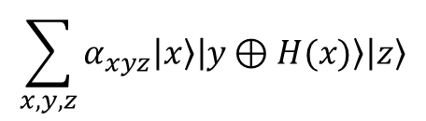





Quantum random oracle model (QROM)
So ROM is not good enough.
Easy fix: add the new, generic power to query $U_{H}$ to the model.
The hash function $H$ in the cryptosystem is modeled like this:
At the start of the world, $H :{\left\{0,1\right\}}^{m}↦{\left\{0,1\right\}}^{n}$ is sampled uniformly at random;
Everyone gets oracle access to $U_{H}$, i.e., a box like this:
Or more succinctly (extend linearly, allowing entanglement implied):
QROM
$$\sum_{x,y,z}{α_{xyz}\left|x\right\rangle \left|y\right\rangle \left|z\right\rangle }$$
$$U_{H}$$
$$\sum_{x,y,z}{α_{xyz}\left|x\right\rangle \left|y⊕H(x)\right\rangle \left|z\right\rangle }$$
$$U_{H}$$
$$\left|x\right\rangle \left|y\right\rangle$$
$$\left|x\right\rangle \left|y⊕H\left(x\right)\right\rangle$$

Slide 9
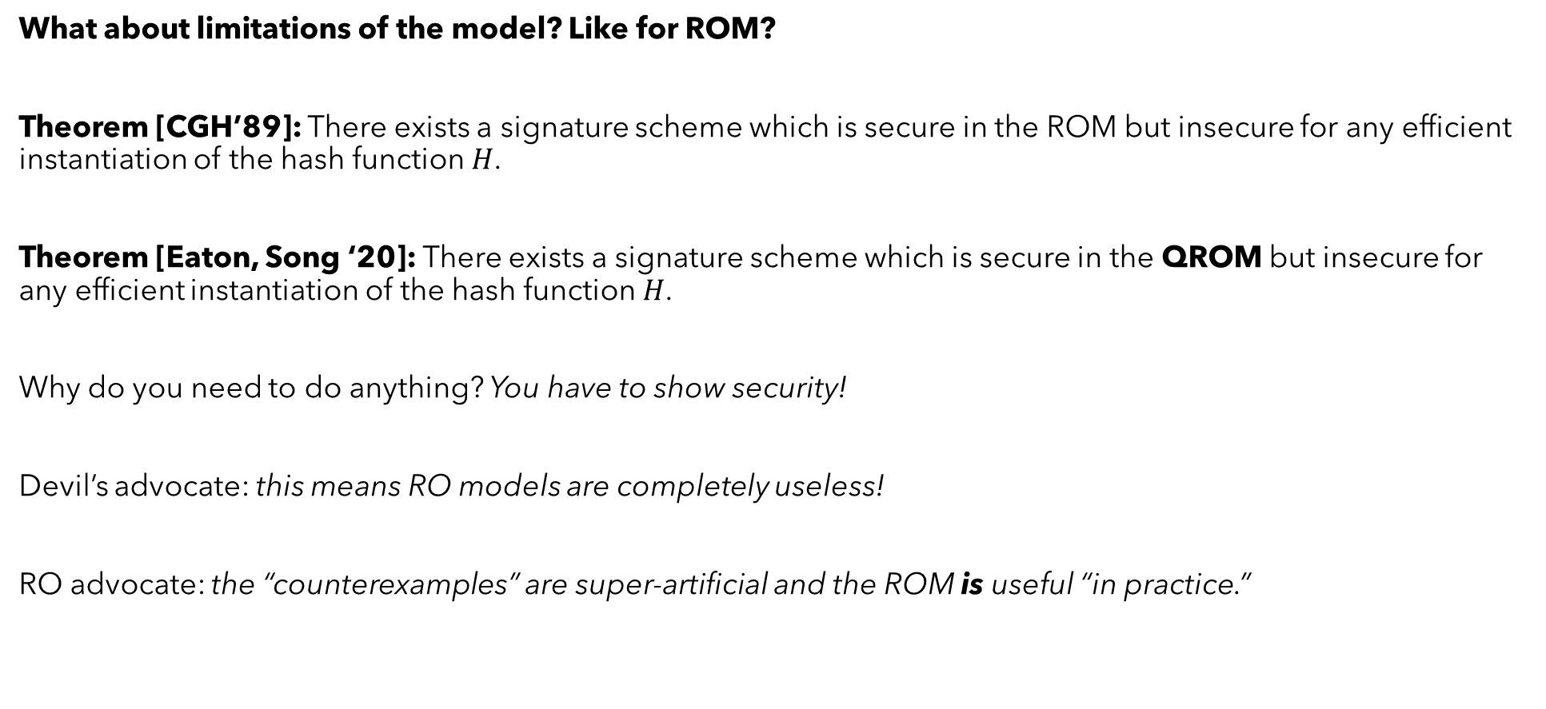
QROM: limitations
What about limitations of the model? Like for ROM?
Theorem [CGH’89]: There exists a signature scheme which is secure in the ROM but insecure for any efficient instantiation of the hash function $H$.
Theorem [Eaton, Song ‘20]: There exists a signature scheme which is secure in the QROM but insecure for any efficient instantiation of the hash function $H$.
Why do you need to do anything? You have to show security!
Devil’s advocate: this means RO models are completely useless!
RO advocate: the “counterexamples” are super-artificial and the ROM is useful “in practice.”

Slide 10




QROM: limitations
Theorem [CGH’89, ES’20]: There exists a signature scheme which is secure in the (Q)ROM but insecure for any efficient instantiation of the hash function.
What’s the scheme idea?
If adversary proves $H$ is not random…
… signing oracle outputs secret signing key $sk$.
$$H$$
Signing oracle
proof $H$ not random
Adversary
$$sk$$

Slide 11



QROM: limitations
Theorem [CGH’89, ES’20]: There exists a signature scheme which is secure in the (Q)ROM but insecure for any efficient instantiation of the hash function.
What’s the scheme idea?
If adversary proves $H$ is not random…
… signing oracle outputs secret signing key $sk$.
Easy to rule out any particular hash $F$!
$$H$$
$$F\left(x\right)=H\left(x\right)$$
$$x$$
Adversary
?
$$sk$$

Slide 12



QROM: limitations
Theorem [CGH’89, ES’20]: There exists a signature scheme which is secure in the (Q)ROM but insecure for any efficient instantiation of the hash function.
What’s the scheme idea?
If adversary proves $H$ is not random…
… signing oracle outputs secret signing key $sk$.
To rule out all $F$ : “diagonalize”!
(Many details and technical obstacles under the rug.)
$$H$$
$$F\left(C_{F}\right)=H\left(C_{F}\right)$$
$$C_{F}$$
Adversary
?
$$sk$$

Slide 13
QROM: security proofs
Can we prove security in QROM?
Sometimes, but it seems harder (you’ve seen some examples.)
In some cases it’s simple (inversion, collision-finding): we know Grover is optimal.
(Technicality: traditional Grover optimality results were worst-case, so we needed to upgrade them to average-case to get crypto-strength. But morally the same proofs work.)
But in general, a lot of classical go-to techniques no longer work.
Most obscene example: lazy sampling.

Slide 14

QROM: security proofs
Lazy sampling.
we’re building some reduction…
… we have an adversary $A$ at our disposal, but $A$ expects to have a random oracle $H$ to talk to;
… how do we simulate $H$ for $A$?
An okay answer: use a PRF.
A sometimes better answer: use a q-wise independent function
Best answer: be lazy.
Whenever $A$ submits a query $x$ :
  give them a random answer $y$
  Record $\left(x, y\right)$ in a table

Slide 15
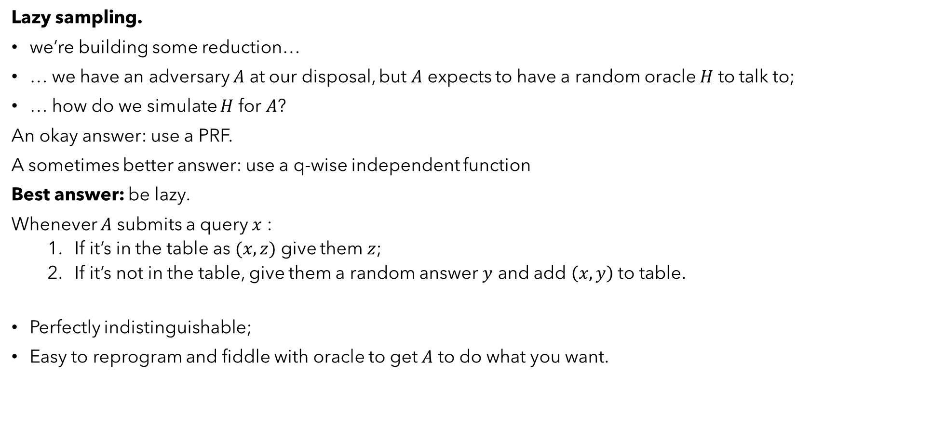
QROM: security proofs
Lazy sampling.
we’re building some reduction…
… we have an adversary $A$ at our disposal, but $A$ expects to have a random oracle $H$ to talk to;
… how do we simulate $H$ for $A$?
An okay answer: use a PRF.
A sometimes better answer: use a q-wise independent function
Best answer: be lazy.
Whenever $A$ submits a query $x$ :
  If it’s in the table as $(x, z)$ give them $z$;
  If it’s not in the table, give them a random answer $y$ and add $\left(x, y\right)$ to table.
Perfectly indistinguishable;
Easy to reprogram and fiddle with oracle to get $A$ to do what you want.

Slide 16
QROM: security proofs
Lazy sampling for QROM?
inputs are now quantum states;
no-cloning: can’t copy and store them into a table;
measurement is destructive: even if I could solve previous problem, no way to “compare” to new inputs;
This problem remained open until 2018. (Was plausible to even conjecture it was impossible.)
Zhandry recording technique.
How to lazy-sample QROM efficiently! Can be used to show:
quantum indifferentiability of Merkle-Damgard and sponge construction;
post-quantum security of Fiat-Shamir (but loose bound);
post-quantum security of Fujisaki-Okamoto (but loose bound);
quantum-query security of (long enough) Feistel networks;
and more…

Slide 17



Zhandry recording technique
$$H←ℱ_{m}^{n}$$
Zhandry recording technique.
Two simple ideas + a clever bit:
Simple idea 1: purify the oracle.
Instead of sampling $H$ randomly…
We
prepare uniform superposition over all $H$
and then measure it at the end.
adversary
oracle
$$\sum_{H∈ℱ_{m}^{n}}{|H⟩}$$
adversary
oracle
measure oracle state

Slide 18


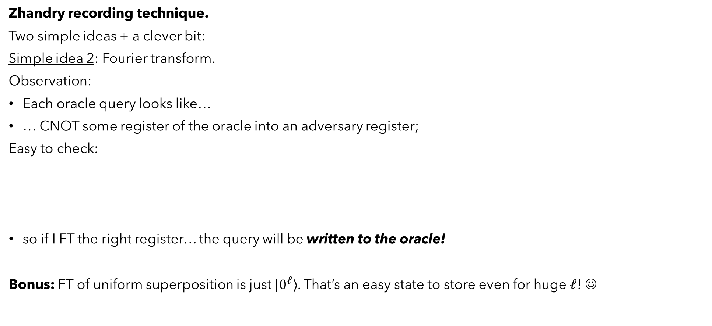

Zhandry recording technique
Zhandry recording technique.
Two simple ideas + a clever bit:
Simple idea 2: Fourier transform.
Observation:
Each oracle query looks like…
… CNOT some register of the oracle into an adversary register;
Easy to check:
so if I FT the right register… the query will be written to the oracle!
Bonus: FT of uniform superposition is just $|0^{ℓ}⟩$. That’s an easy state to store even for huge $ℓ$! ☺
$$\left|x\right\rangle \left|y\right\rangle$$
$$U_{H}$$
$$\left|x\right\rangle \left|y⊕H\left(x\right)\right\rangle$$
H
H
$$=$$
H
H

Slide 19
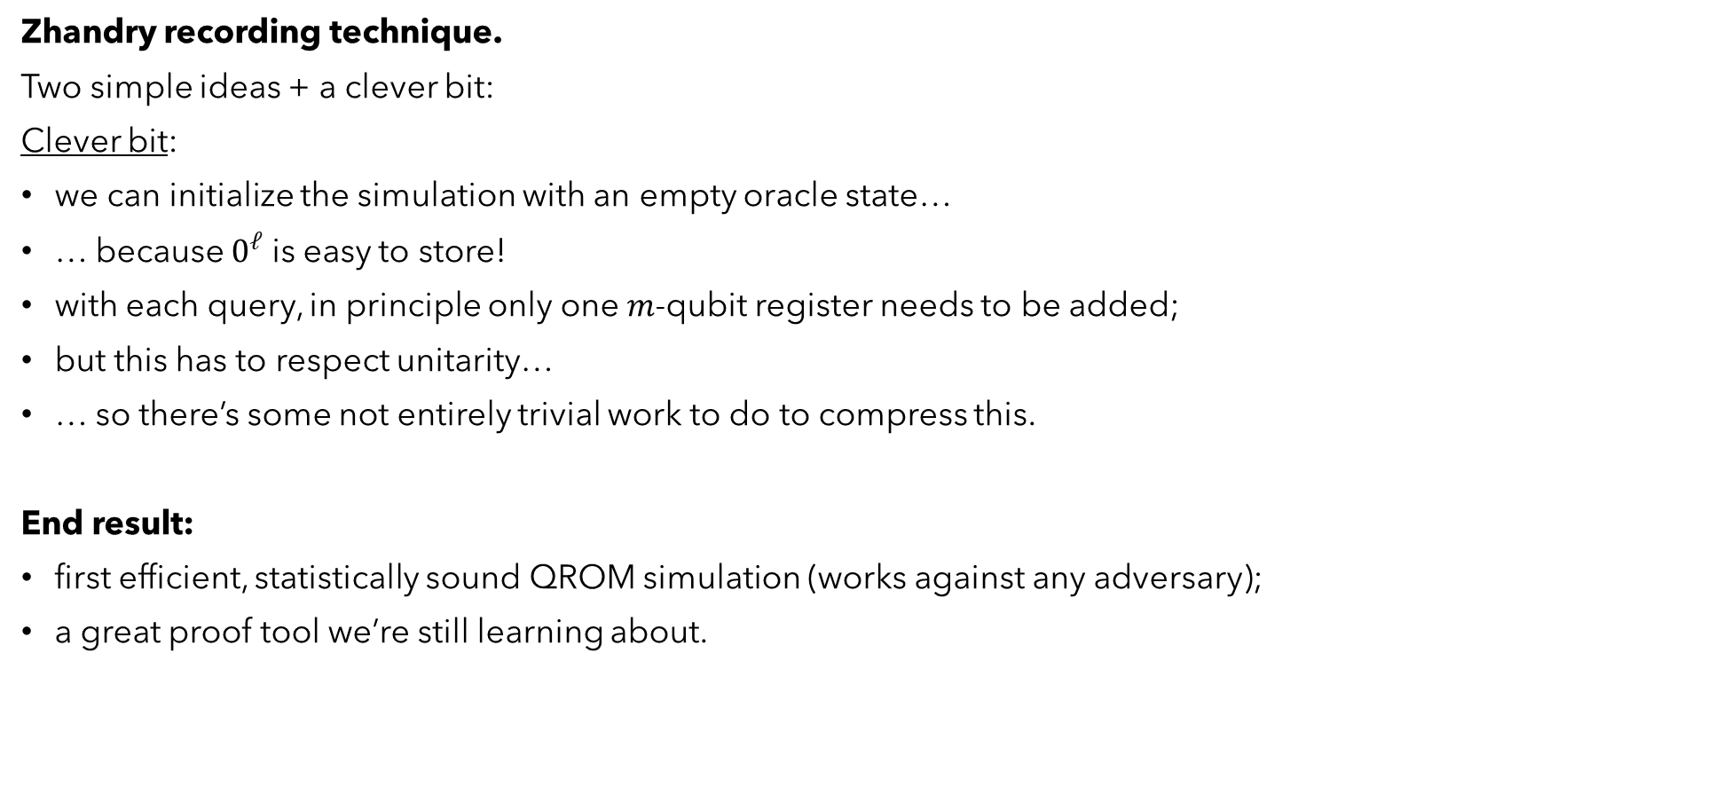
Zhandry recording technique
Zhandry recording technique.
Two simple ideas + a clever bit:
Clever bit:
we can initialize the simulation with an empty oracle state…
… because $0^{ℓ}$ is easy to store!
with each query, in principle only one $m$-qubit register needs to be added;
but this has to respect unitarity…
… so there’s some not entirely trivial work to do to compress this.
End result:
first efficient, statistically sound QROM simulation (works against any adversary);
a great proof tool we’re still learning about.

Slide 20
Difference between ROM and QROM?
ROM vs QROM?
the models are obviously semantically different;
but it seems like, eventually…
… everything secure in the ROM is eventually also proven secure in the QROM.
so maybe they’re just the same model?
ROM = QROM
Other reasons to believe this:
In quantum oracle algorithms, we know that:
For problems without a promise, quantum query complexity is poly-equivalent to classical;
In all our exponential oracle speedups, the oracle has some large-scale symmetry.
So is it true?
?

Slide 21
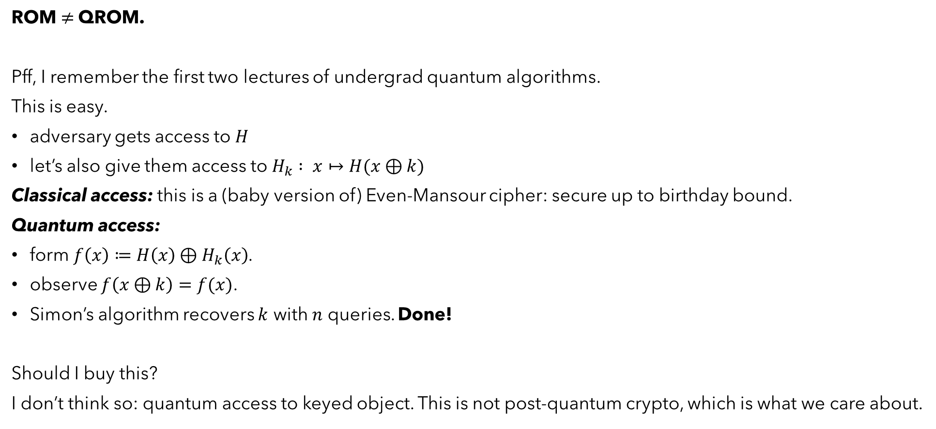
Difference between ROM and QROM?
ROM $≠$QROM.
Pff, I remember the first two lectures of undergrad quantum algorithms.
This is easy.
adversary gets access to $H$
let’s also give them access to $H_{k} : x↦H(x⊕k)$
Classical access: this is a (baby version of) Even-Mansour cipher: secure up to birthday bound.
Quantum access:
form $f\left(x\right)≔H\left(x\right)⊕H_{k}\left(x\right)$.
observe $f\left(x⊕k\right)=f(x)$.
Simon’s algorithm recovers $k$ with $n$ queries. Done!
Should I buy this?
I don’t think so: quantum access to keyed object. This is not post-quantum crypto, which is what we care about.

Slide 22
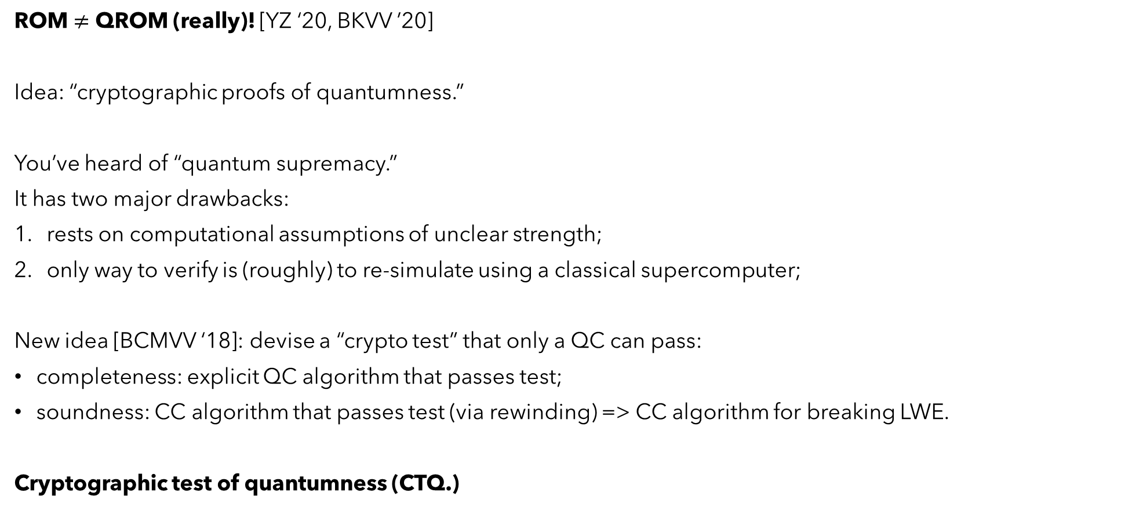
Difference between ROM and QROM?
ROM $≠$ QROM (really)! [YZ ‘20, BKVV ’20]
Idea: “cryptographic proofs of quantumness.”
You’ve heard of “quantum supremacy.”
It has two major drawbacks:
rests on computational assumptions of unclear strength;
only way to verify is (roughly) to re-simulate using a classical supercomputer;
New idea [BCMVV ‘18]: devise a “crypto test” that only a QC can pass:
completeness: explicit QC algorithm that passes test;
soundness: CC algorithm that passes test (via rewinding) => CC algorithm for breaking LWE.
Cryptographic test of quantumness (CTQ.)

Slide 23

Difference between ROM and QROM?
ROM $≠$ QROM (really)! [YZ ‘20, BKVV ’20]
Upgraded idea [BKVV ‘20]:
devise a non-interactive “crypto test” that only a QC can pass…
… using a hash function modeled as a random oracle.
[YZ’20]:
this is not just a proof of quantum computation!
it’s a proof of quantum access to the random oracle!
What’s the test?

Slide 24

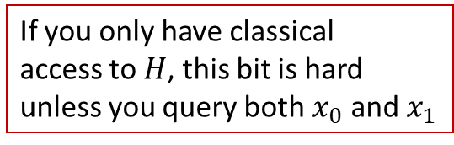






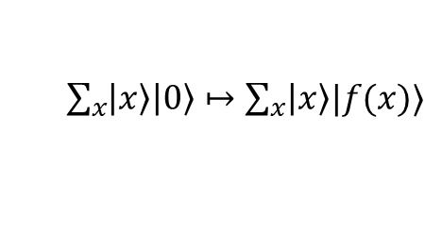
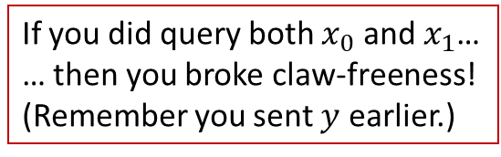
Cryptographic test of quantumness (CTQ)
Main ingredient: trapdoor claw-free function $f(b, x)$ from LWE.
Think: it’s one-way and exactly two-to-one.
Prover should:
query $f$ on uniform superposition
measure output register
now query $H$
Fourier transform and measure
send result to verifier.
Verifier can easily check if output is correct because they hold trapdoor.
$$(0, x_{0})$$
$$f$$
$$y$$
$$(1, x_{1})$$
$\sum_{x}{\left|x\right\rangle \left|0\right\rangle ↦\sum_{x}{\left|x\right\rangle |f(x)⟩}}$
If you only have classical
access to $H$, this bit is hard
unless you query both $x_{0}$ and $x_{1}$
$\left(\left|x_{0}\right\rangle + | x_{1}\right\rangle )|y⟩$
$$\left|x_{0}\right\rangle \left|H\left(x_{0}\right)\right\rangle +\left|x_{1}\right\rangle |H\left(x_{1}\right)⟩$$
$(d, m)$ such that $m=d⋅\left(x_{0}⊕x_{1}\right)⊕H\left(x_{0}\right)⊕H\left(x_{1}\right)$
If you did query both $x_{0}$ and $x_{1}$…
… then you broke claw-freeness!
(Remember you sent $y$ earlier.)

Slide 25
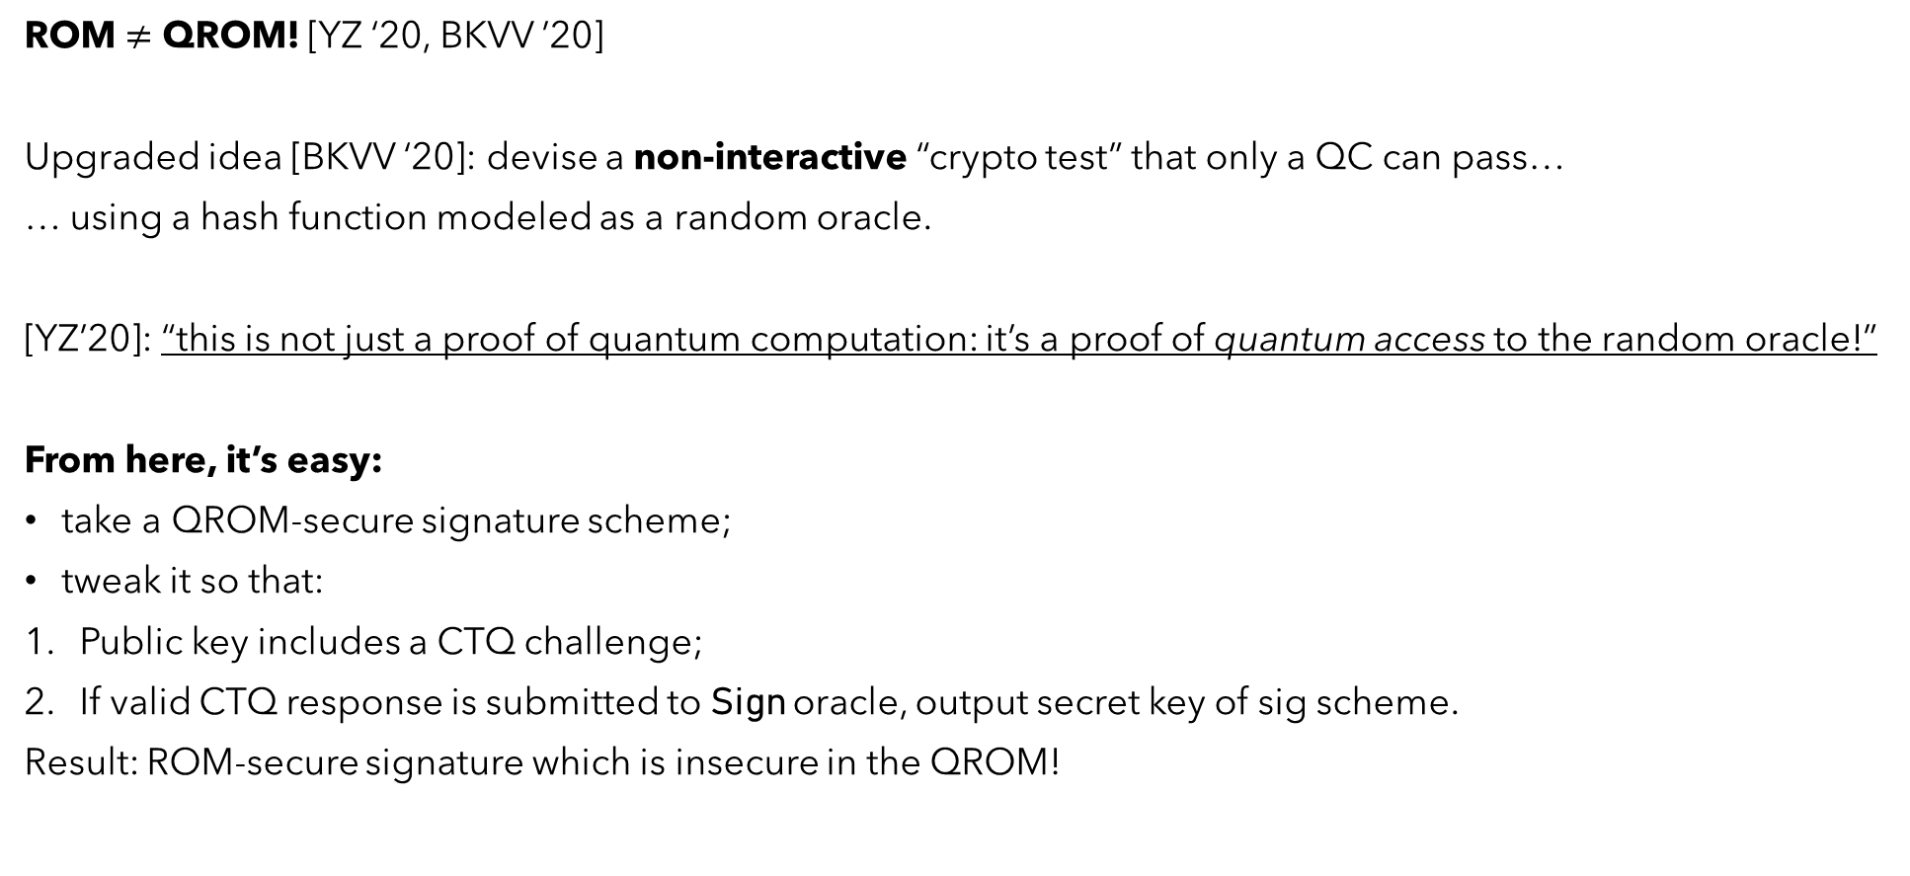
Difference between ROM and QROM?
ROM $≠$ QROM! [YZ ‘20, BKVV ’20]
Upgraded idea [BKVV ‘20]: devise a non-interactive “crypto test” that only a QC can pass…
… using a hash function modeled as a random oracle.
[YZ’20]: “this is not just a proof of quantum computation: it’s a proof of quantum access to the random oracle!”
From here, it’s easy:
take a QROM-secure signature scheme;
tweak it so that:
Public key includes a CTQ challenge;
If valid CTQ response is submitted to Sign oracle, output secret key of sig scheme.
Result: ROM-secure signature which is insecure in the QROM!

Slide 26
So…
Should we worry? I don’t think so.
For all the concrete cases of QROM security we care about…
… we have proofs.
The counterexample is pretty artificial.
We still don’t know of any examples “in the wild” where QROM is an issue.
Also, why not:
Updated conjecture: for information-theoretic security, ROM=QROM.

Slide 27
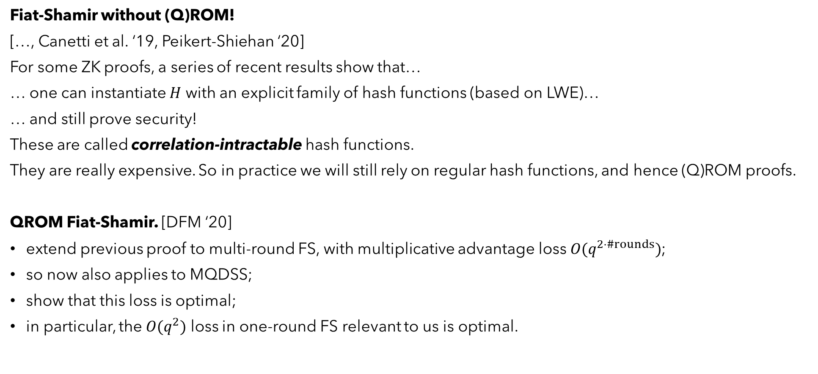
Other interesting happenings
Fiat-Shamir without (Q)ROM!
[…, Canetti et al. ‘19, Peikert-Shiehan ‘20]
For some ZK proofs, a series of recent results show that…
… one can instantiate $H$ with an explicit family of hash functions (based on LWE)…
… and still prove security!
These are called correlation-intractable hash functions.
They are really expensive. So in practice we will still rely on regular hash functions, and hence (Q)ROM proofs.
QROM Fiat-Shamir. [DFM ‘20]
extend previous proof to multi-round FS, with multiplicative advantage loss $O(q^{2⋅\#rounds})$;
so now also applies to MQDSS;
show that this loss is optimal;
in particular, the $O(q^{2})$ loss in one-round FS relevant to us is optimal.

